Slide 1
Lab 6b Working with DNA

Slide 2
Amplifying DNA
Polymerase chain reaction (PCR)
  Molecular
  Increases the amount of a DNA sequence
  Replicates sequence millions of times
Recombinant DNA technology
Amplifies DNA that includes
  Within cells
  Sequences from other organisms

Slide 3
Working With Gene Clones
Polymerase chain reaction
  used to copy specific gene sequences
    three basic steps
      denaturation
      annealing of primers
      primer extension

Slide 4
Amplifying DNA in vitro by PCR
    Small amount of double-stranded DNA
    DNA precursors
    Specific nucleic acid primers
    Taq DNA polymerase
  DNA is denatured
  Primers attach to primer-binding site on each DNA strand
  Each strand acts as template for DNA synthesis

Slide 5
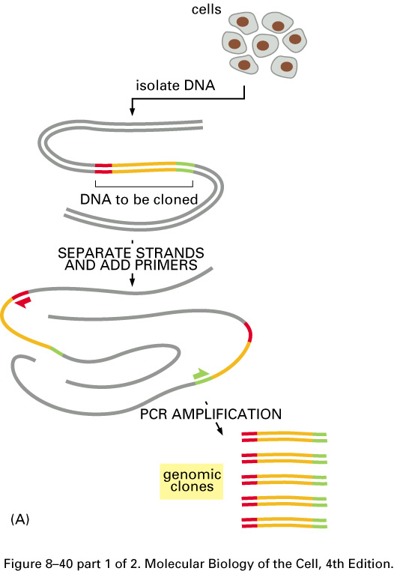

Slide 6
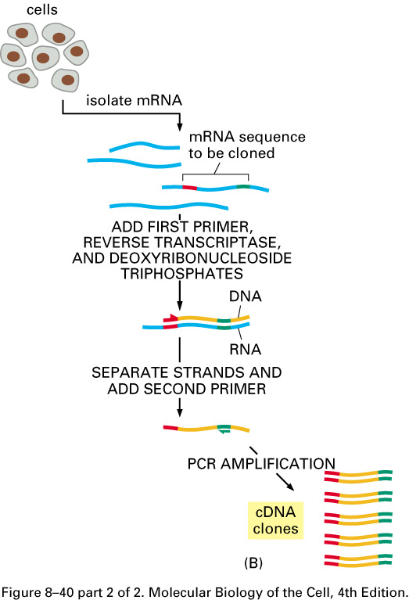

Slide 7
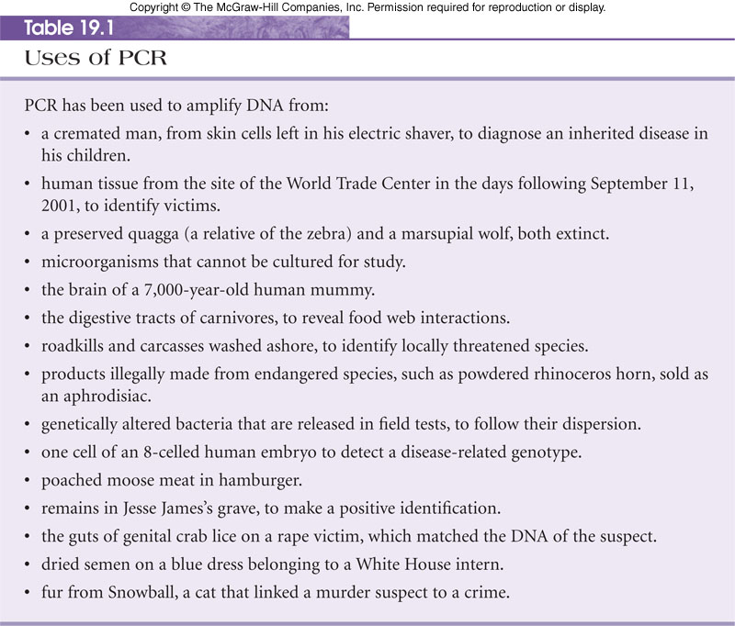
Uses of PCR

Slide 8
Recombinant DNA
Recombinant DNA is a molecule that combines DNA from two sources
Creates a new combination of genetic material
Human gene for insulin was placed in bacteria to make large quantities for diabetics
Genetically modified organisms are possible because of the universal nature of the genetic code

Slide 9
Generation of Recombinant Plasmid
Recombinant plasmid: plasmid containing the piece of DNA you isolated
Put piece of DNA you isolated with sticky ends together with plasmid that is cut with same restriction enzyme
Sticky ends of isolated DNA will join to sticky ends of plasmid
Add ligase to glue isolated DNA to plasmid

Slide 10
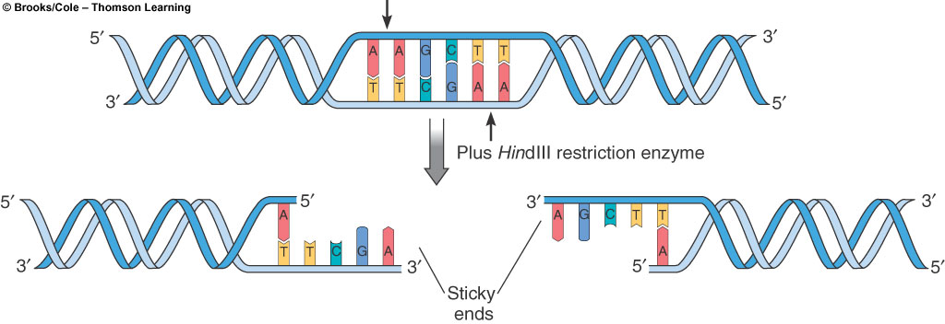
Cutting DNA with a restriction enzyme

Slide 11
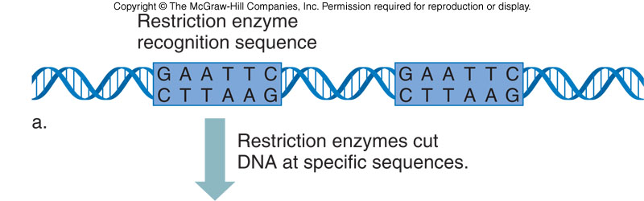
Creating Recombinant DNA Molecules

Slide 12
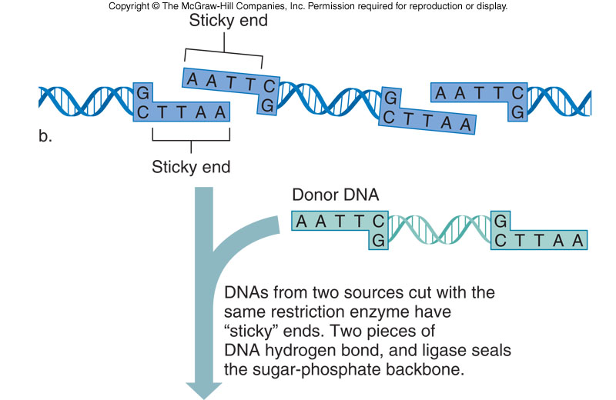

Slide 13
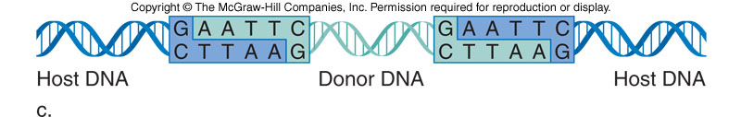

Slide 14
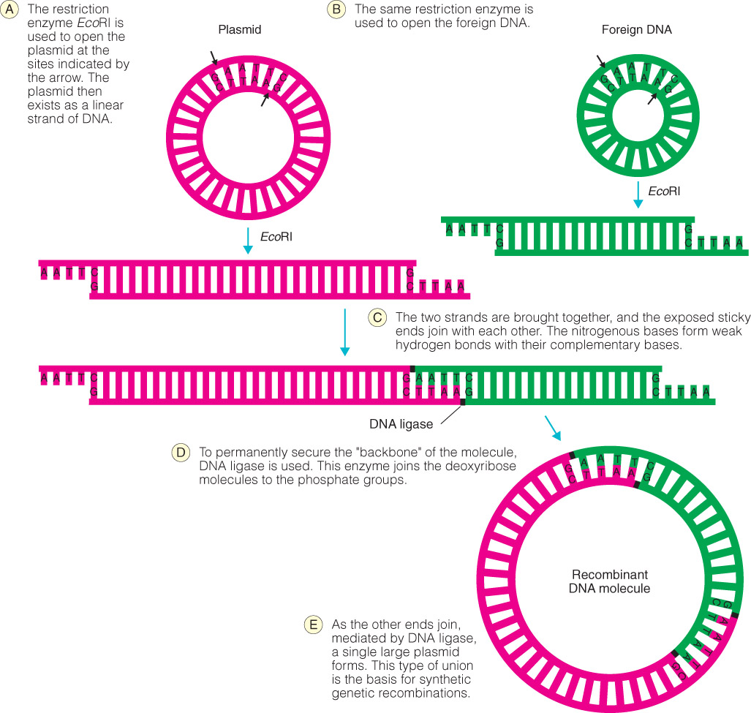
Same restriction enzyme used to isolate DNA of interest

Slide 15
Restriction Endonucleases
Restriction endonucleases recognize specific nucleotide sequences, and cleave DNA creating DNA fragments.
  Type I - simple cuts
  Type II - dyad symmetry
    allows physical mapping
    allows recombinant molecules

Slide 16
Restriction Endonucleases
Each restriction endonuclease has a specific recognition sequence and can cut DNA from any source into fragments.
    Because of complementarity, single-stranded ends can pair with each other.
      sticky ends
        fragments joined together with DNA ligase

Slide 17
Restriction Enzymes Recognize Specific DNA Sequences (Recognition Sites)
EcoRI
5’GGATCGAATTCCCGATTTCAAT
3’CCTAGCTTAAGGGCTAAAGTTA
a palindrome reads the same
left-to-right in the top strand and
right-to-left in the bottom strand

Slide 18
Cutting and Rejoining DNA
restriction enzymes (RE) produce specific DNA fragments for ligation
  RE are defensive weapons against viruses
  RE “cut” (hydrolyze) DNA at specific sites
  RE “staggered cuts” produce “sticky ends”
  sticky ends make ligation more efficient

Slide 19
Cleaving and Rejoining DNA
RE produce many different DNA fragments
  for a 6 bp recognition site
    1/4⁶ = 1/4096 x 3x10⁹ bp/genome =
    7.3 x10⁵ different DNA fragments
gel electrophoresis sorts DNA fragments by size
hybridization with a labeled probe locates specific DNA fragments

Slide 20
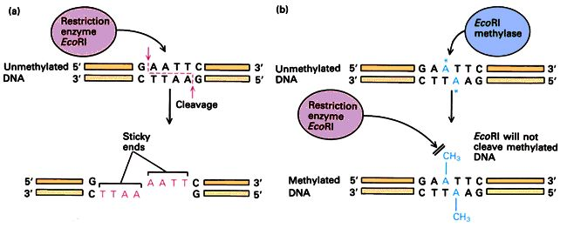
Restriction Enzymes
called “restriction enzymes” because restrict host range for certain bacteriophage
bacterial “immune system” destroy any “non-self” DNA
methylase recognizes same sequence in host DNA and protects it by methylating it; restriction enzyme destroys unprotected = non-self DNA (restriction/modification systems)

Slide 21
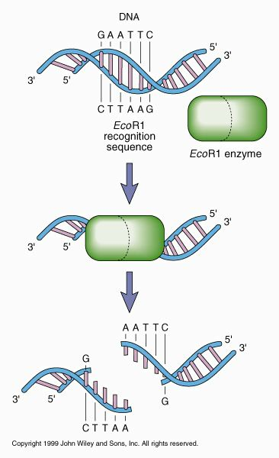
Restriction Enzymes
Hundreds of restriction enzymes have been identified.
Most recognize and cut palindromic sequences
Many leave staggered (sticky) ends
by choosing correct enzymes can cut DNA very precisely
Important for molecular biologists because restriction enzymes create unpaired "sticky ends" which anneal with any complementary sequence

Slide 22
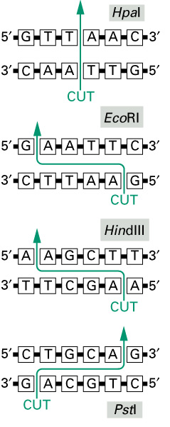

Slide 23
Some Commonly Used
Restriction Enzymes
Eco RI 5'-G | AATTC
Eco RV 5'-GAT | ATC
Hin D III 5'-A | AGCTT
Sac I 5'-GAGCT | C
Sma I 5'-CCC | GGG
Xma I 5'-C | CCGGG
Bam HI I 5'-G | GATCC
Pst I I 5'-CTGCA | G

Slide 24
Theoretical Basis
Using Restriction Enzymes
The activity of restriction enzymes is dependent upon precise environmental conditions:
PH
Temperature
Salt Concentration
Ions
An Enzymatic Unit (u) is defined as the amount of enzyme required to digest 1 ug of DNA under optimal conditions:
3-5 u/ug of genomic DNA
1 u/ug of plasmid DNA
Stocks typically at 10 u/uL

Slide 25
DNA Electrophoresis Analysis after Endonuclease Digestion
Restriction
enzymes
C A B A+B L
A B
10 kb
A
8 kb
2 kb
B
7 kb
3 kb
A
+
B
5 kb
3 kb
2 kb

Slide 26
Creating Recombinant DNA Molecules
Cut DNA from donor and recipient with the same restriction enzymes
Cut DNA fragment is combined with a vector
Vector DNA moves and copies DNA fragment of interest
Vector cut with restriction enzymes
The complementary ends of the DNAs bind and ligase enzyme reattaches the sugar-phosphate backbone of the DNA

Slide 27
Cloning Genes
genetic engineering requires lots of DNA
  cloning produces lots of exact copies
  DNA clones are replicated by host cells
  DNA is cloned in a DNA vector
  a DNA vector has an origin of replication (ori) that the host cell recognizes

Slide 28
Host / Vector Systems
DNA propagation in a host cell requires a vector that can enter the host and replicate.
  most flexible and common host is E. coli
  two most commonly used vectors are plasmids and phages
    viruses and artificial chromosomes also being probed for use

Slide 29
Ligation/Transformation
ligation of vector to insert produces several products
  vector ligated to itself (recircularized)
  insert ligated to itself (circularized, no ori)
  two vectors ligated together
  two (or more) inserts ligated together
  several DNAs ligated together, but not circularized
  1 vector ligated to 1 insert DNA

Slide 30
Ligation/Transformation
transformation is a very inefficient process
1 µg typical plasmid vector = 3 × 10¹¹ copies added to highly competent E. coli cells yields at best 10⁹ antibiotic resistant colonies
3 × 10¹¹/10⁹ = 300 vectors/transformed E. coli

Slide 31
Ligation/Transformation
ligation produces a mess of products
transformation is an inefficient random process
selection (antibiotic) sorts out successful vector transformations
screening identifies transformants with the insert in the vector

Slide 32
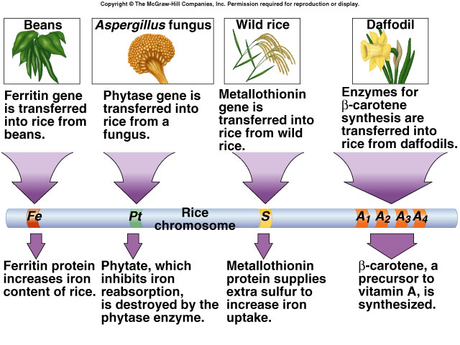
Transgenic Rice

Slide 33
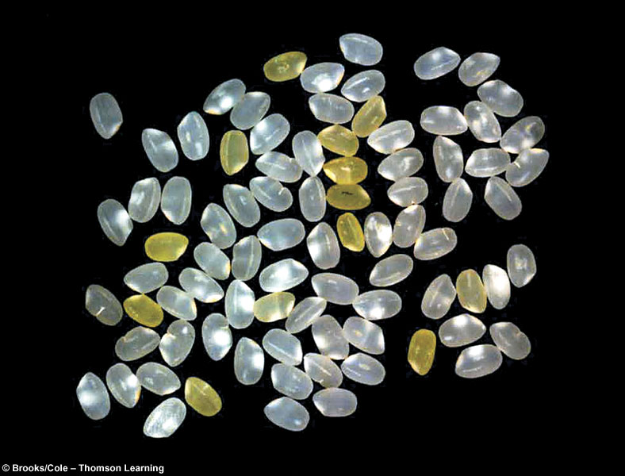
Transgenic Rice
“Golden rice” shown intermixed with white rice contain high concentrations of beta-carotene

Slide 34
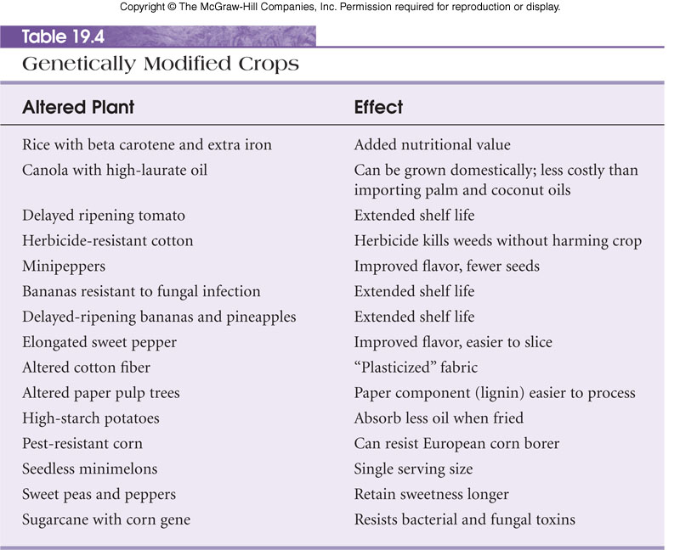

Slide 35
DNA Electrophoresis
The process using electro-field to separate macromolecules in a gel matrix is called electrophoresis.
DNA, RNA and proteins carry negative charges, and migrate into gel matrix under electro-fields.
The rate of migration for small linear fragments is directly proportional to the voltage applied at low voltages.
At low voltage, the migration rate of small linear DNA fragments is a function of their length.
At higher voltages, larger fragments (over 20kb) migrate at continually increasing yet different rates.
Large linear fragments migrate at a certain fixed rate regardless of length.
In all cases, molecular weight markers are very useful to monitor the DNA migration during electrophoresis

Slide 36
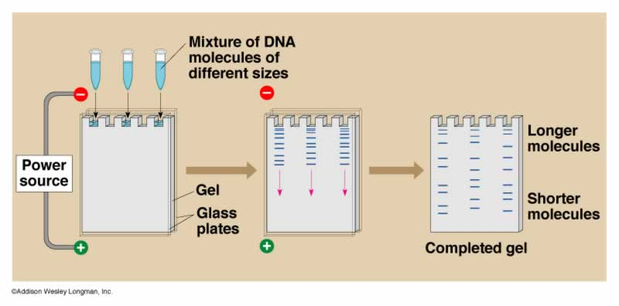
Theoretical Basis of Agarose Gel Electrophoresis
Agarose is a polysaccharide from marine alage that is used in a matrix to separate DNA molecules
Because DNA ia a (-) charged molecule when subjected to an electric current it will migrate towards a (+) pole

Slide 37
Sizing a Piece of DNA
The distance the DNA migrates is dependent upon
  the size of the DNA molecule
  the secondary structure of the DNA
  the degree of crosslinking in the gel matrix
Size of DNA molecule can be determined by using standards of known molecular weight
  a standard curve is made by plotting the molecular weights of the standards and the distance each fragment has migrated from
  measuring the distance the unknown fragment migrated from the well
  substituting the distance the unknown migrated into the equation of the line of best fit, and solving for Y (the molecular wt)

Slide 38
Selection of Buffer
RE | Buffer 1 | Buffer 2 | Buffer 3 | Buffer 4
HindIII | 50% | 100% | 10% | 50%
PstI | 75% | 75% | 100% | 50%

